Slide 1
Introduction to Optical Tweezers
PEEC 2022
Pedro Jorge, Nuno Azevedo Silva

Slide 2
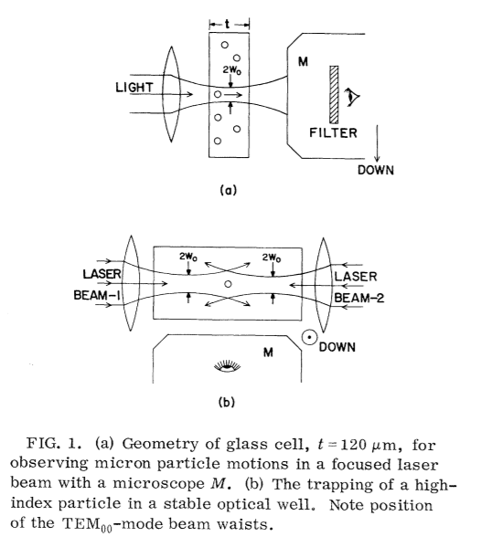
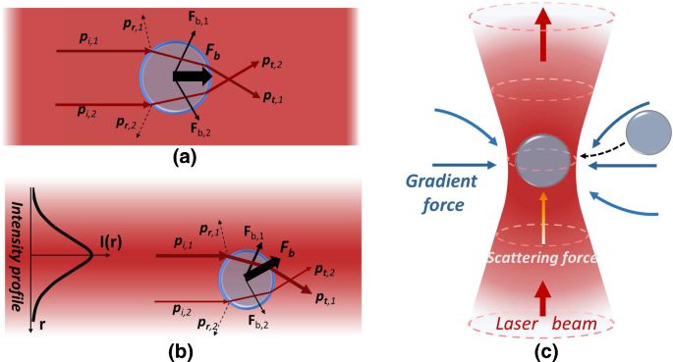
Optical Tweezers
1986, Ashkin – Biological samples
Started with two lasers(1970)
And evolved to a single beam configuration(1986)

Slide 3
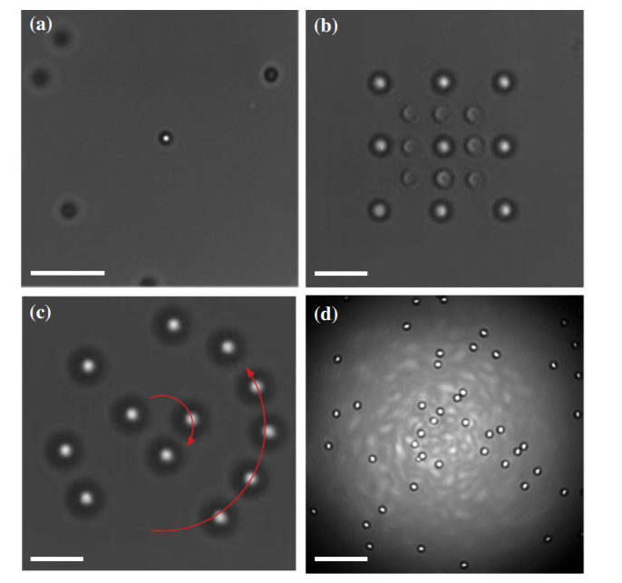
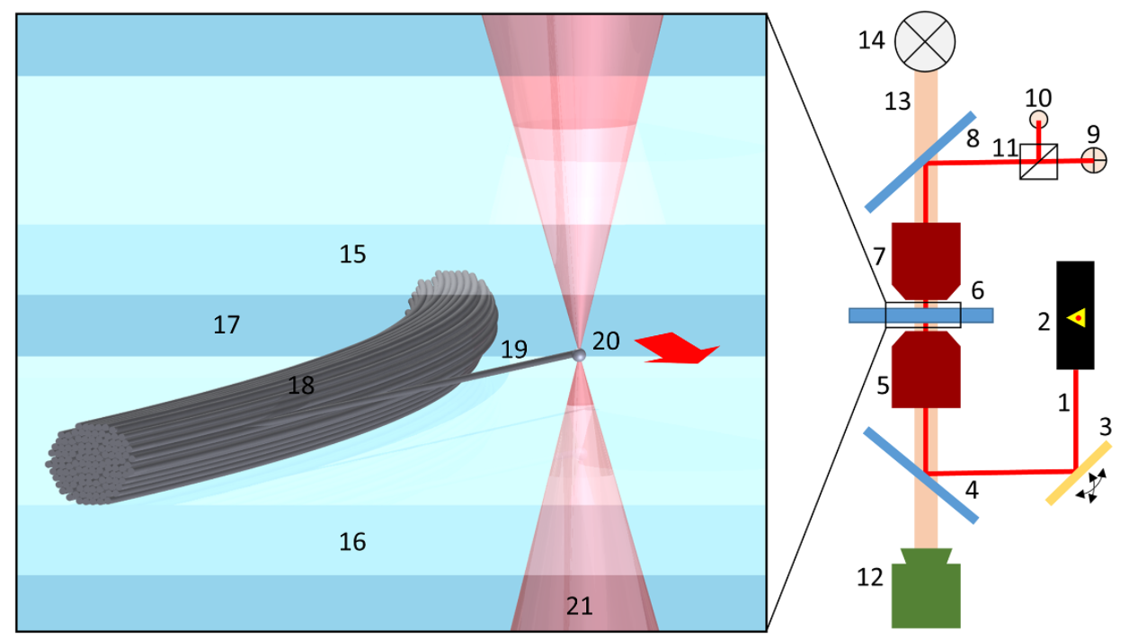
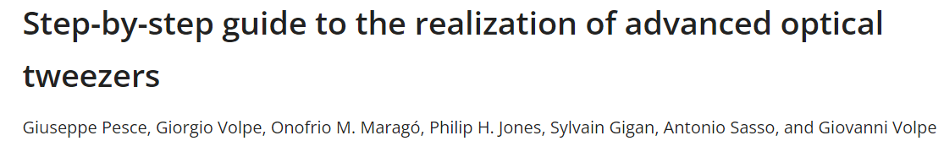
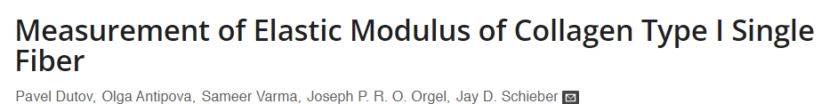
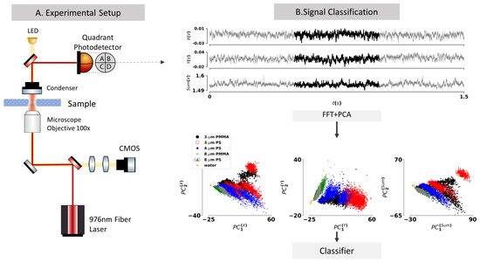
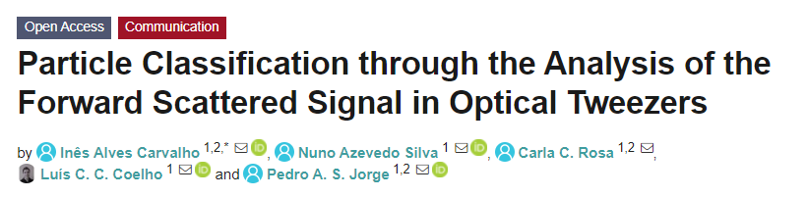
Some Applications
Manipulating particles
Sensing small forces
Probing small particles

Slide 4
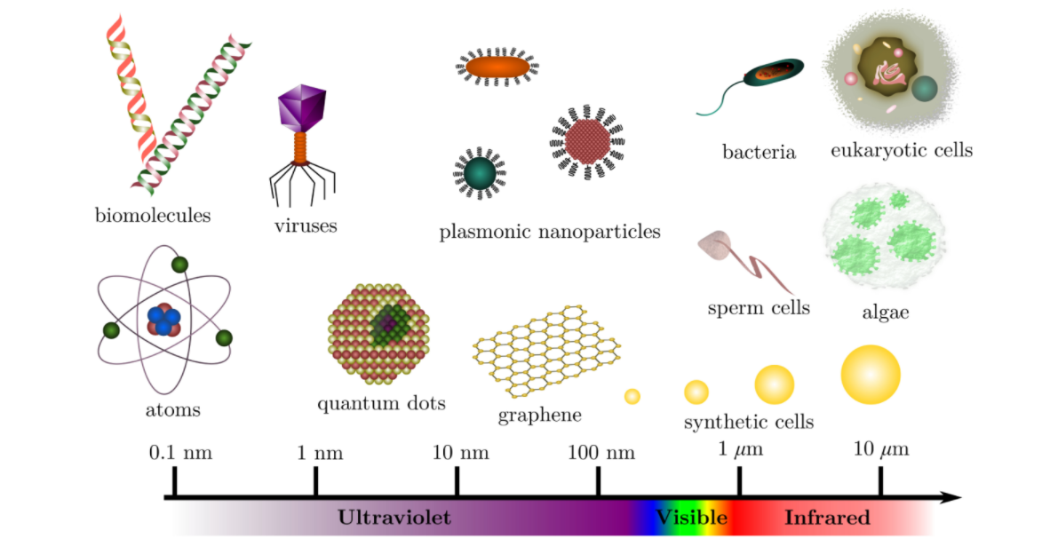
Not everything is trappable nor at any wavelength
Thus one must choose and configure our setup properly with solid theoretical framework

Slide 5
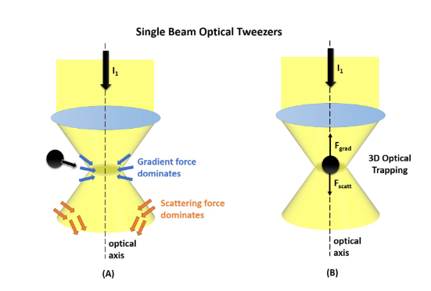
Theoretical Concepts
Interplay of two optically induced forces:
The Gradient force
Beam shape
The Scattering force
Radiation pressure

Slide 6
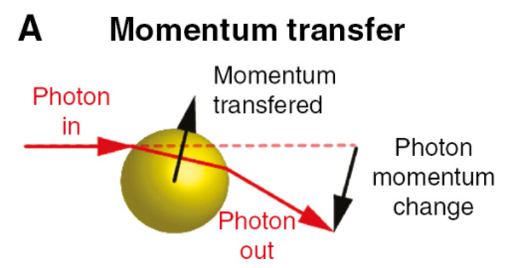
Scattering Force

Slide 7
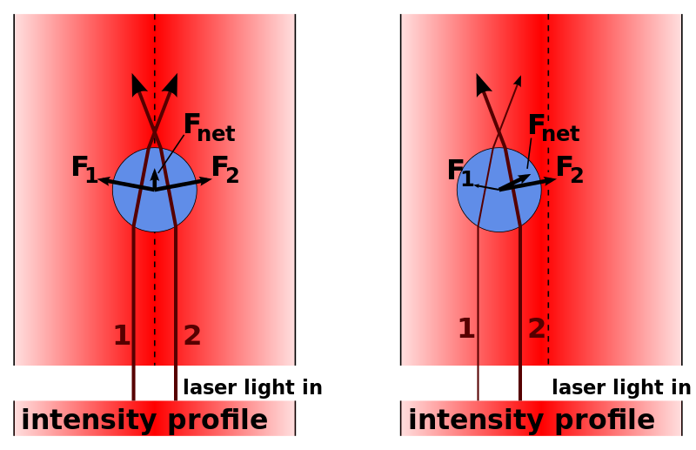
Gradient Force

Slide 8
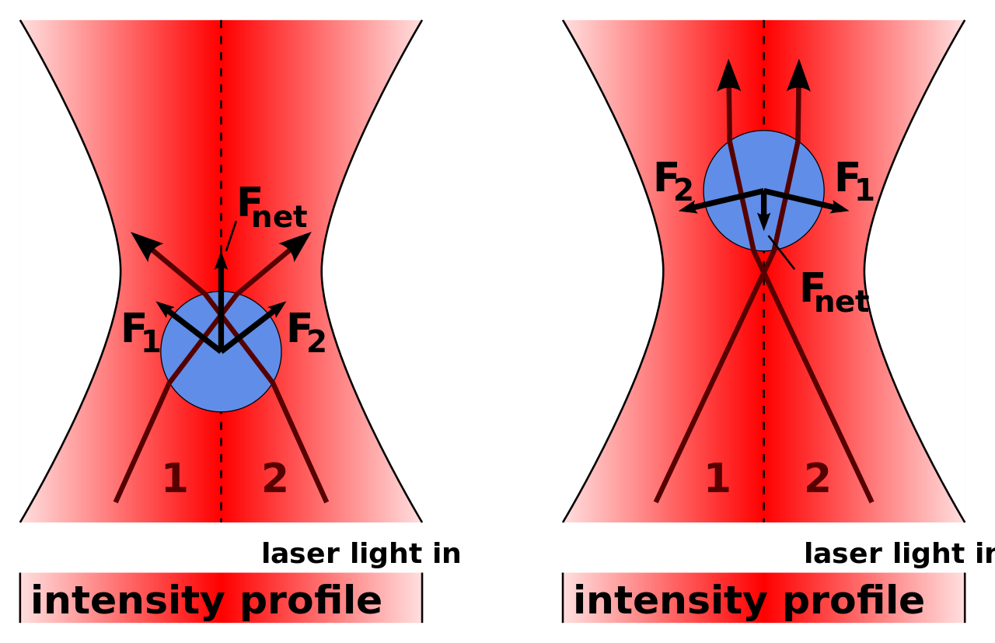
Gradient Force and Scattering Force

Slide 9
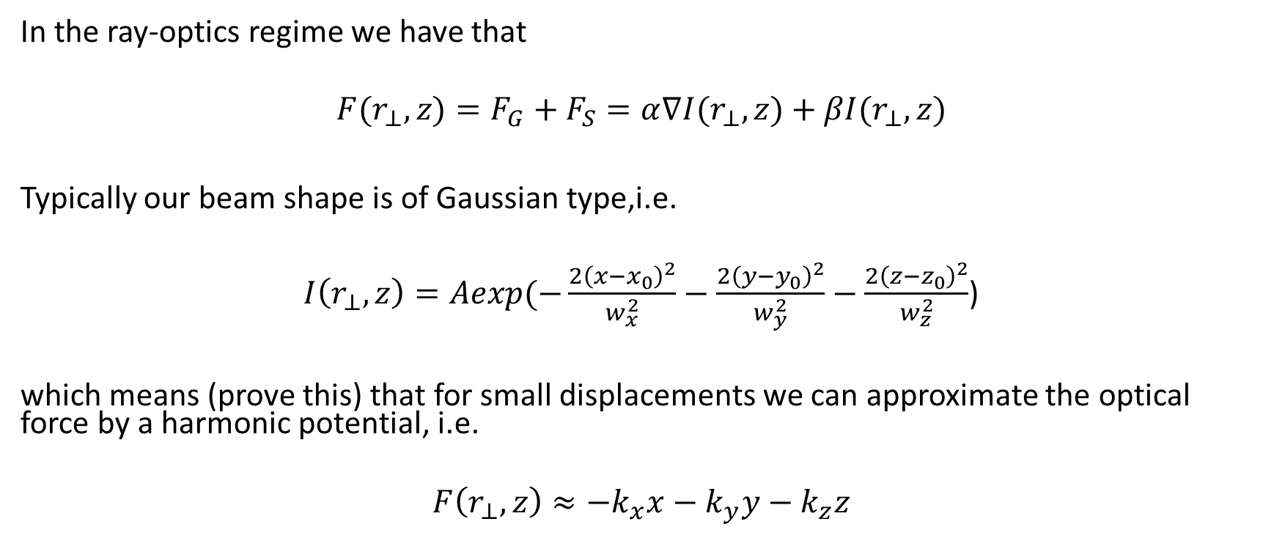
Harmonic approximation
In the ray-optics regime we have that
$$F(r_{⊥},z)=F_{G}+F_{S}=α∇I(r_{⊥},z)+βI(r_{⊥},z)$$
Typically our beam shape is of Gaussian type,i.e.
$I\left(r_{⊥},z\right)=Aexp(−\frac{2{\left(x−x_{0}\right)}^{2}}{w_{x}^{2}}−\frac{2{\left(y−y_{0}\right)}^{2}}{w_{y}^{2}}−\frac{{2\left(z−z_{0}\right)}^{2}}{w_{z}^{2}}$)
which means (prove this) that for small displacements we can approximate the optical force by a harmonic potential, i.e.
$$F\left(r_{⊥},z\right)≈−k_{x}x−k_{y}y−k_{z}z$$

Slide 10

Brownian motion
In the microscopic world, a particle with a size comparable to that of the molecules of the immersion fluid is permanently moving in random directions.
This is called the Brownian motion and is described by the Langevin equation:

Slide 11
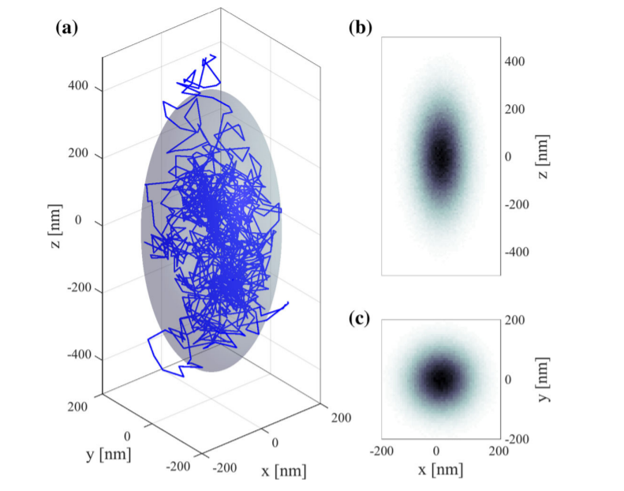

Trapped particle with Brownian motion
Thus the motion of a microscopic trapped particle can be described by the model

Slide 12
Experimental Concepts
Typically we can divide the optical systems setups into 2 different configurations:
Conventional Laboratory Setup
Fiber Optical Tweezers

Slide 13
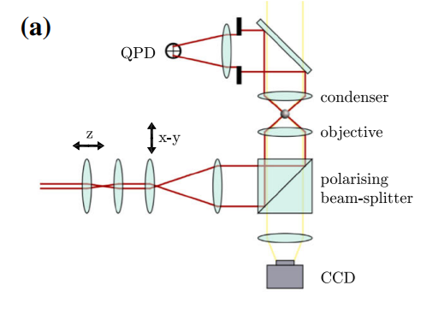
Conventional Configuration
More stable, allows complete control without significant setup or complexity additions
Allows to trap in 3 dimensions
Reliable setup to make force measurements
One can measure both back and forward scattered radiation

Slide 14
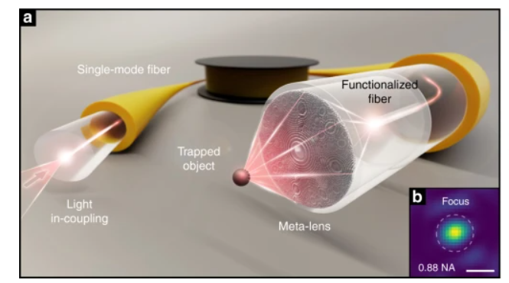
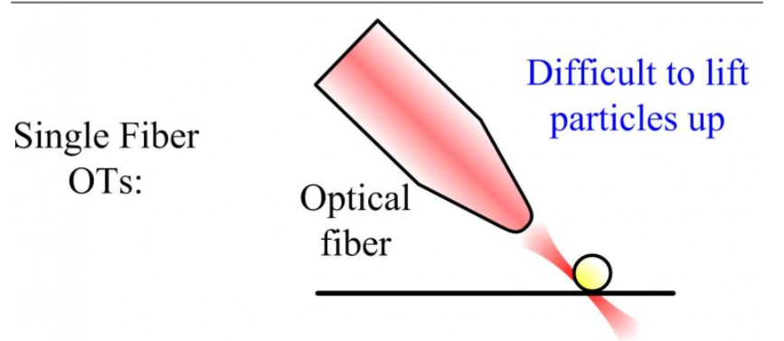
Fiber Optic Configuration
Less stable but more flexible, e.g. can be used in vivo
With just a polymeric tip on the lens only allowed to trap in 2 dimensions
We can only recover the backscattered radiation

Slide 15
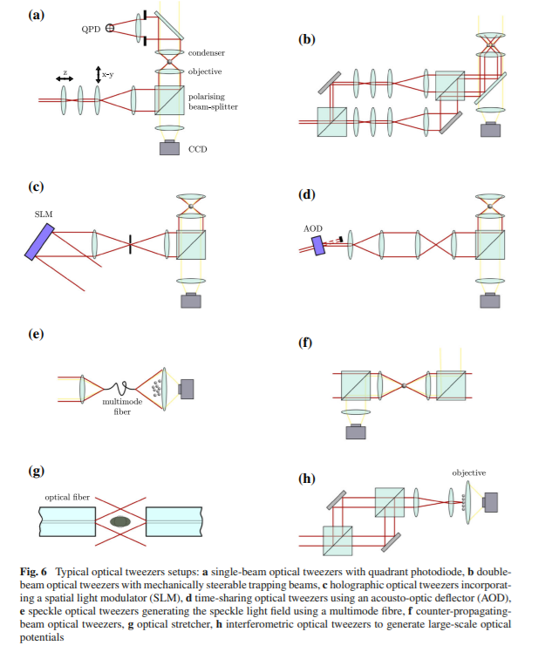
Additional configurations

Slide 16
Calibration - How can we find the optical force?
The calibration of an optical tweezers entails the determination of the value of the optical trap stiffness, which in general depends on the properties of both the light beam and the particle.
There are many methods that mostly divide into passive (no external force applied) and active(external force applied).
Some of the most common:
Equipartition method
Power spectral density
Potential analysis

Slide 17
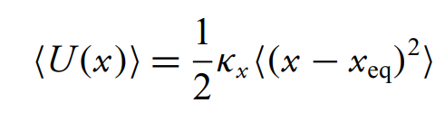
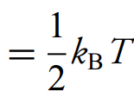
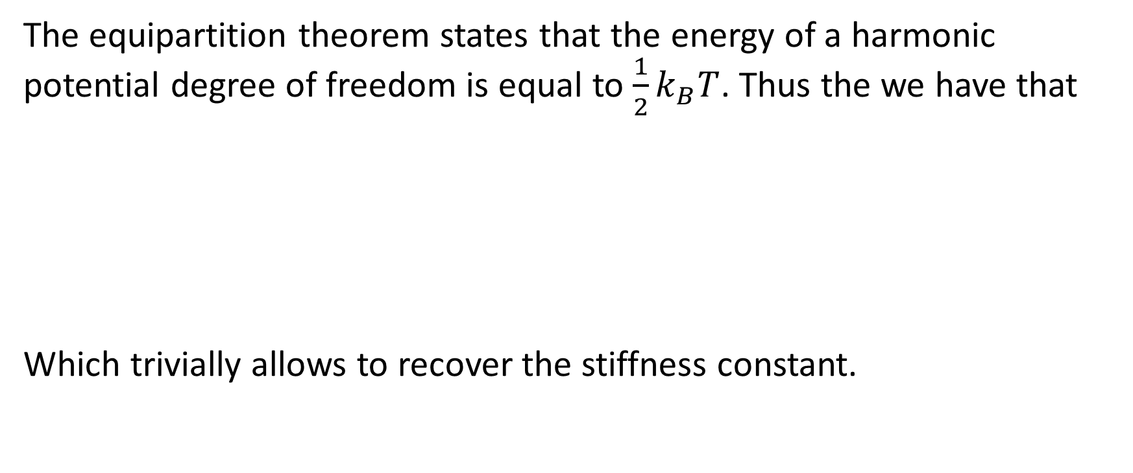
Equipartition method
The equipartition theorem states that the energy of a harmonic potential degree of freedom is equal to $\frac{1}{2}k_{B}T$. Thus the we have that
Which trivially allows to recover the stiffness constant.

Slide 18
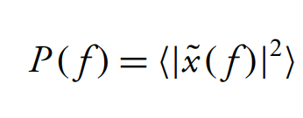
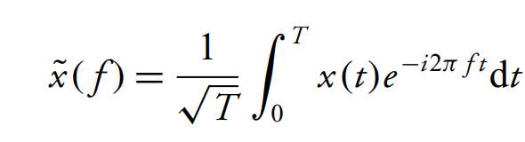
Power spectral density
The power spectral density is defined as
With

Slide 19
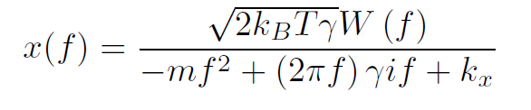

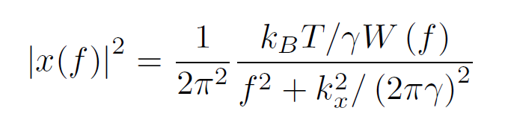
Power spectral density
Substituting into the Langevin equation we obtain
Solving for x
And squaring

Slide 20
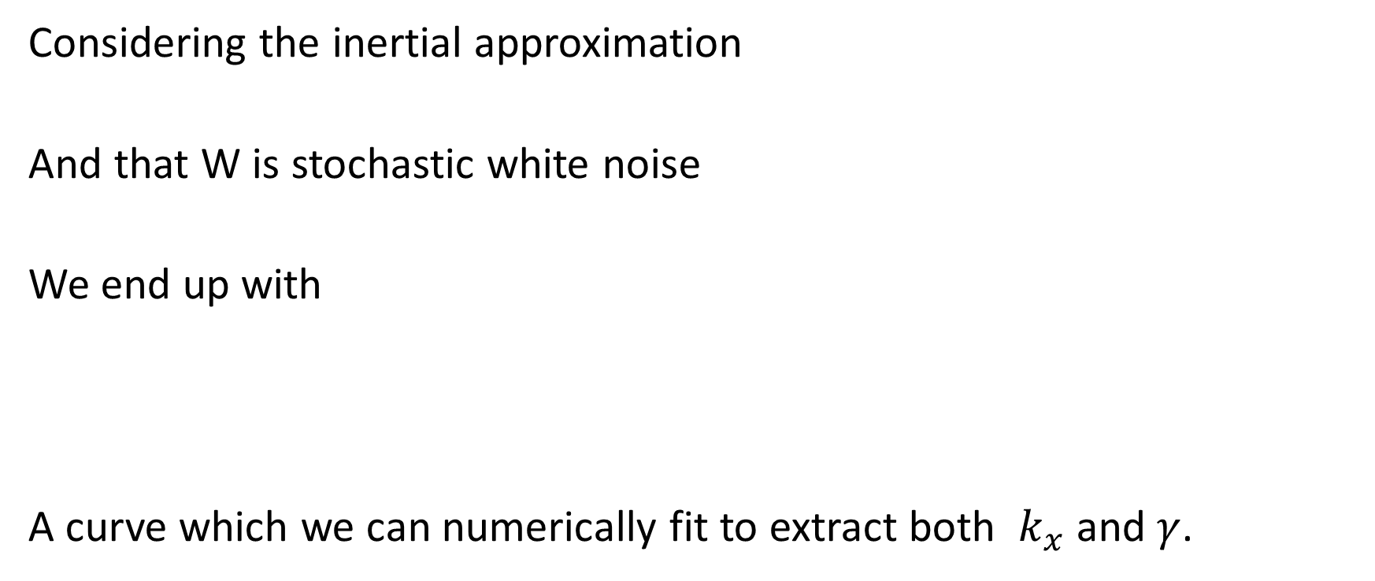
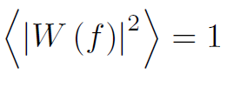
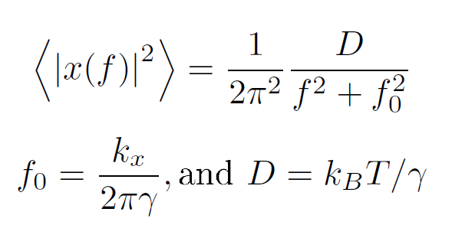
Power spectral density
Considering the inertial approximation
And that W is stochastic white noise
We end up with
A curve which we can numerically fit to extract both $k_{x}$and $γ$.

Slide 21
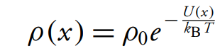
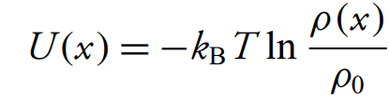
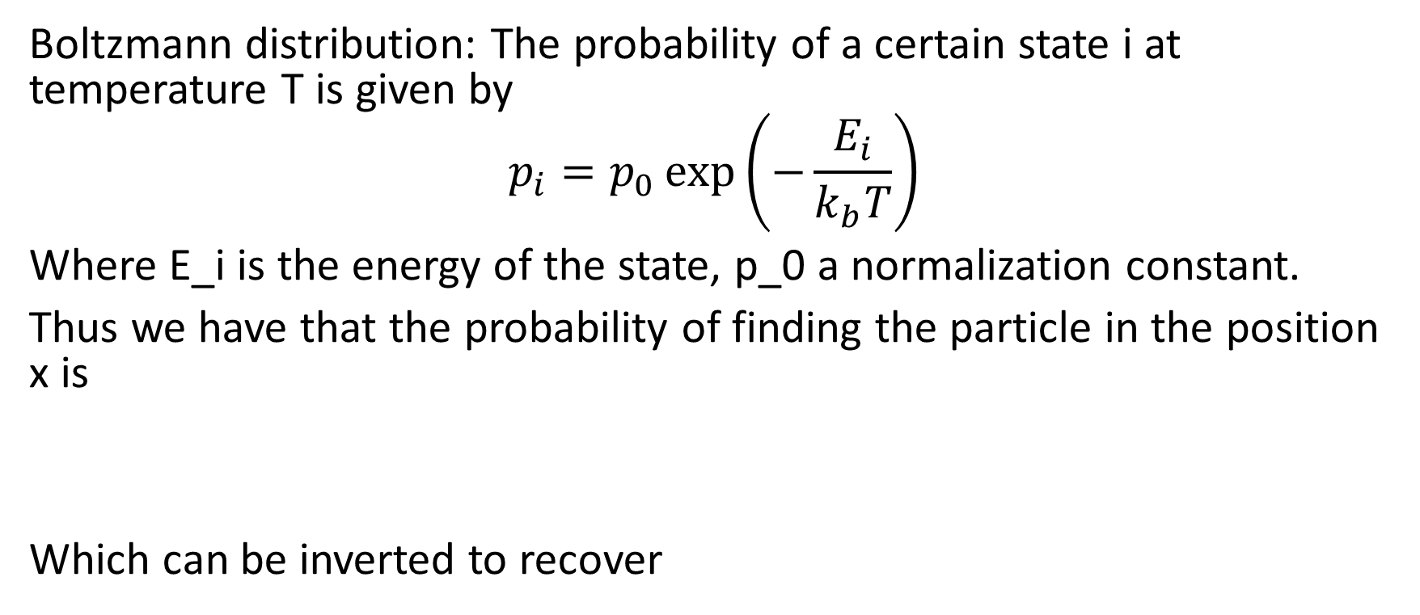
Potential Analysis
Boltzmann distribution: The probability of a certain state i at temperature T is given by
$$p_{i}=p_{0}\exp\left(−\frac{E_{i}}{k_{b}T}\right)$$
Where E_i is the energy of the state, p_0 a normalization constant.
Thus we have that the probability of finding the particle in the position x is
Which can be inverted to recover

Slide 22
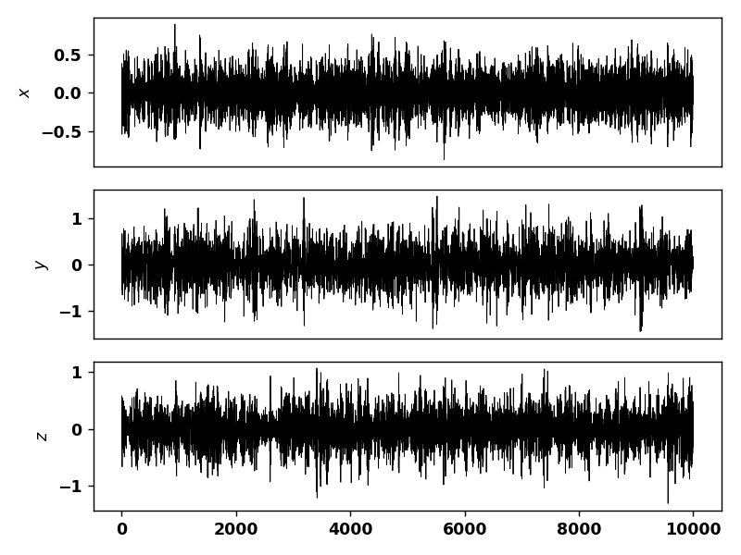
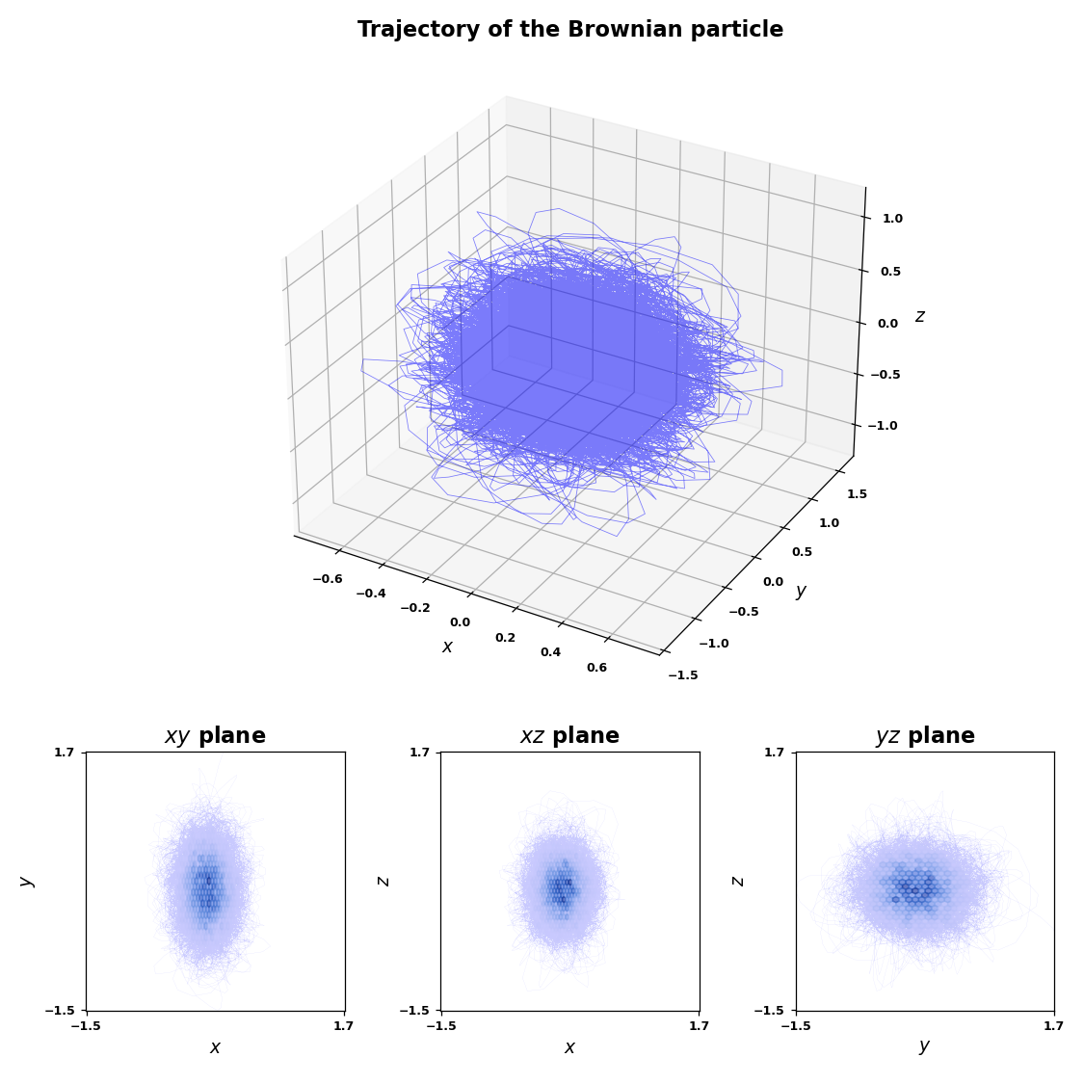
Week 1 Task
Explore Trapped Brownian motion with a numerical simulator, plotting time series x(t), y(t) and z(t) and a 2D (xy) histogram.

Slide 23
Week 1 Task (cont)
Apply the 3 methods introduced to recover k_x and gamma when possible.
Apply the same methods to the data obtained in the laboratory, discuss the results.
Link to repo: https://github.com/nunoazevedosilva/PEEC_2021_OT

